Slide 1

Welcome to:
Tuesday, October 3, 2017
Broun Hall Room 235

Slide 2
Introduction
Founded in 2006 by the Auburn University ECE Department
Acts as a “makerspace” that provides a place for students to work collaboratively on projects.
Provides the space, tools, and some resources for these projects.
No prior experience is required.
Great for students of all ages and majors.
Can act as a pathway to get involved in Undergraduate Research.

Slide 3


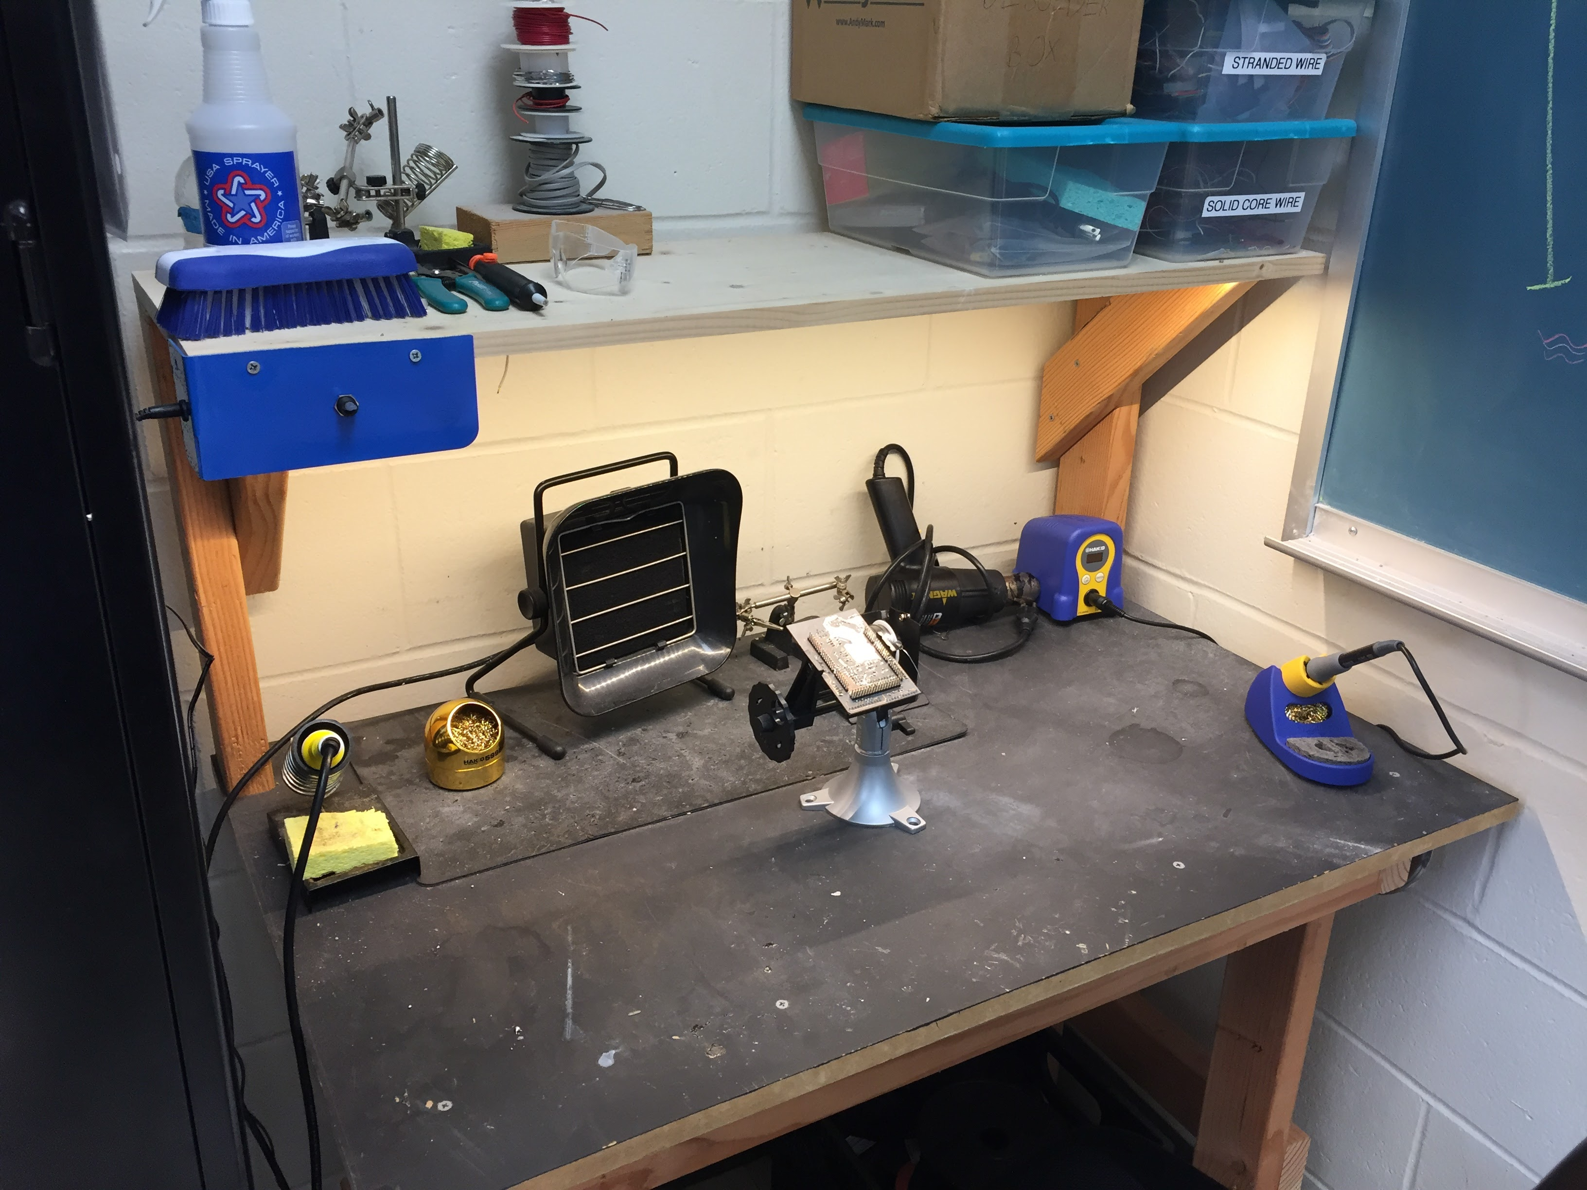
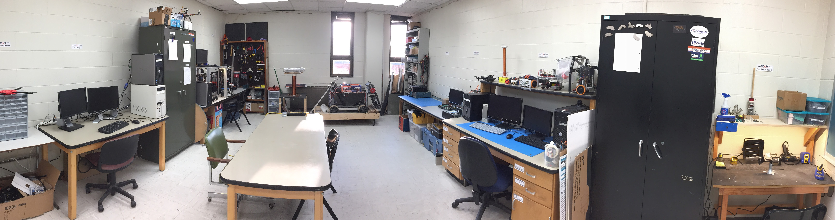
Our Lab
Broun Hall
Room: 367

Slide 4
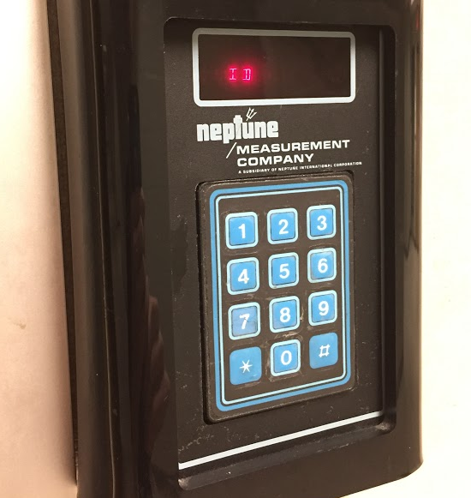
How to become a Member
Log 5 constructive hours in the lab
Write the times on the sheet on the cabinet on the left side of the room.
Contact us at Sparc.Auburn@gmail.com:
Include your Banner ID #
You will be given code access code that will give you 24/7 access to Broun 367 and Broun Hall.

Slide 5
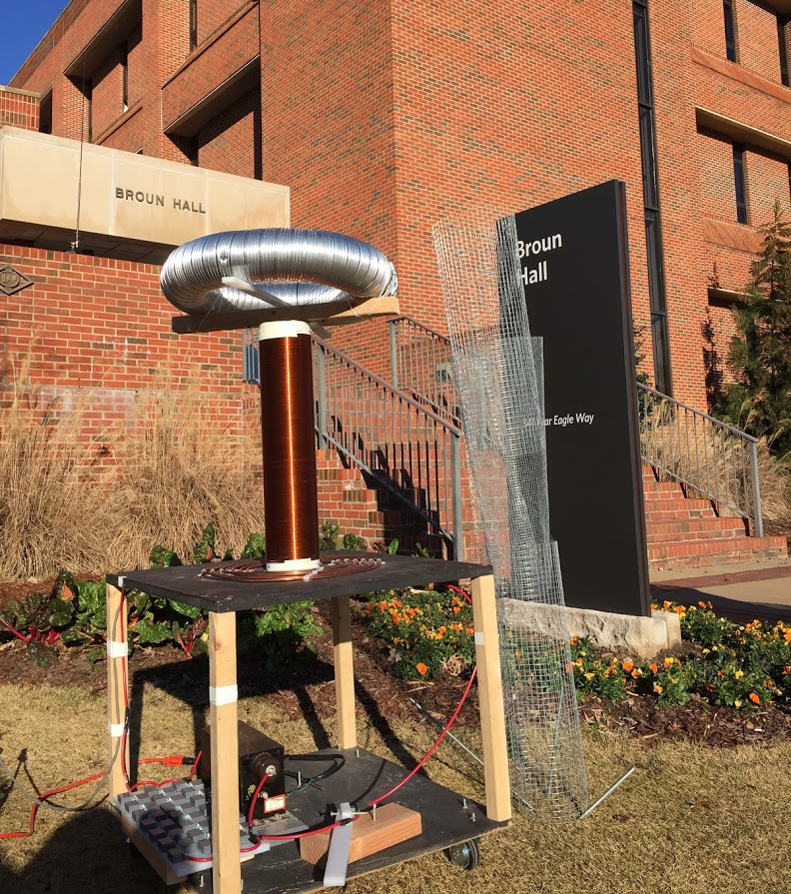
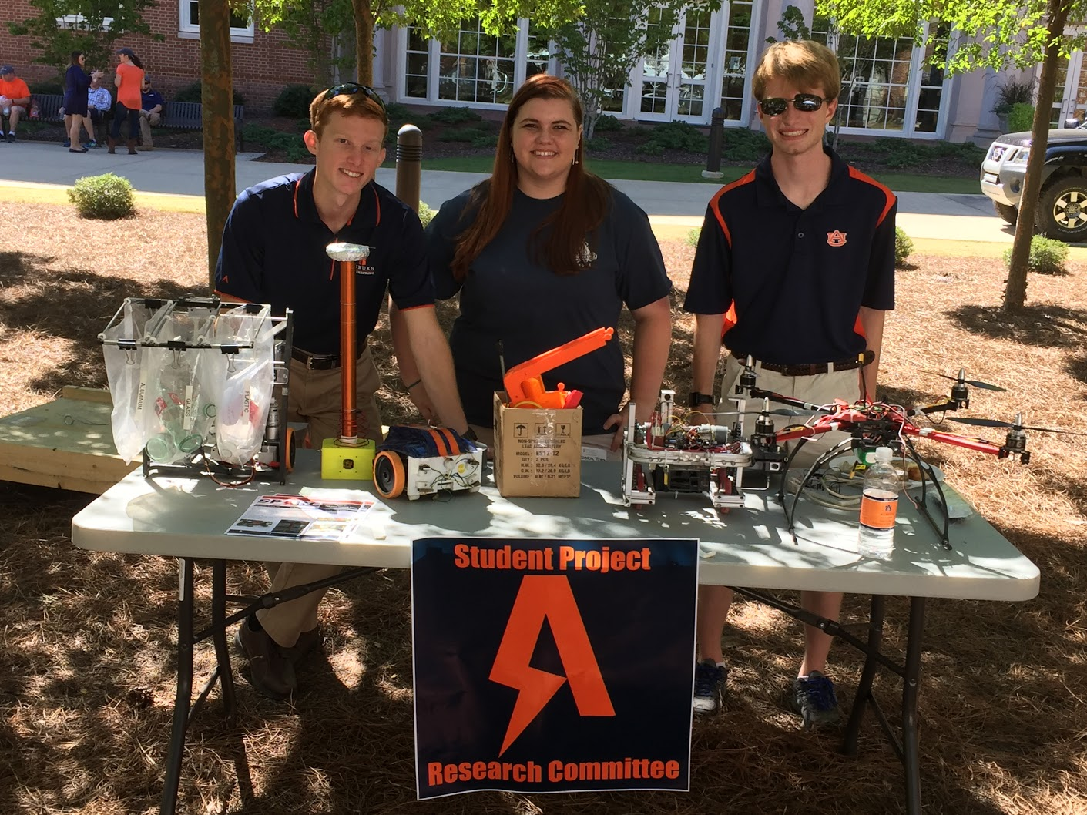
Outreach Events
Outreach Coordinator: Matthew Zacune
BEST
We have started mentoring a BEST Robotics team in the Auburn area. We are looking for more students to help with mentoring the team. They meet after school at Opelika High School.
M: 3:30-7:00, T-R: 3:30-5:30.
E-Day 2016 Tesla Coil Demonstration
Engineering Tailgate SPARC Table
Notes:
Fall 2016
Loachapoka Robotics Mentoring- Mondays, Tuesdays, and Thursdays 3:00PM to 4:30PM
ECE Minority Presentation- November 14th
AJHS E-Day- November 17th
South’s Best- December 3-4th
SCORE Claw Machine- December 3-4th
Spring 2016
E-Day- Late February or early March
SPACE Day- Possible Event Next Semester
IEEE Sumo Robotics Competition (with local middle and high schools)- Spring 2017

Slide 6
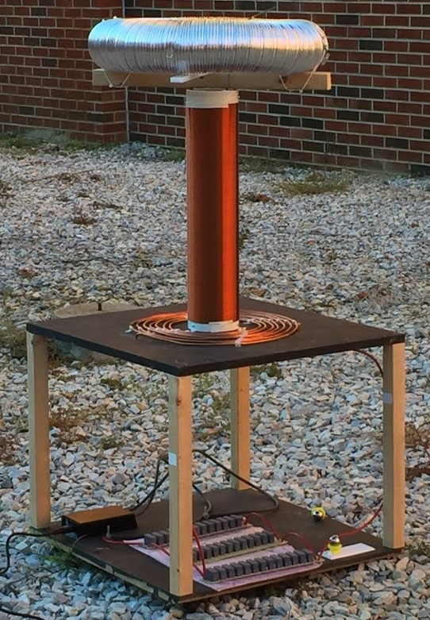
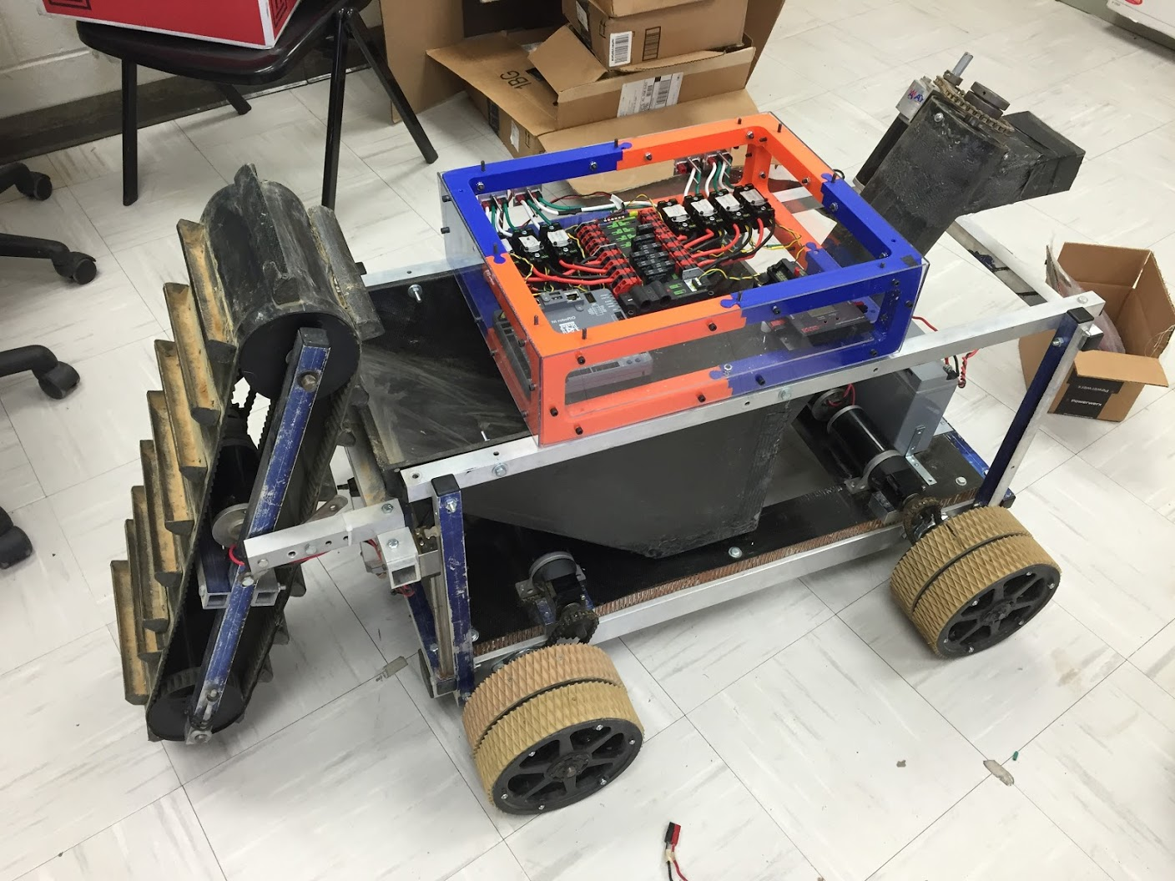
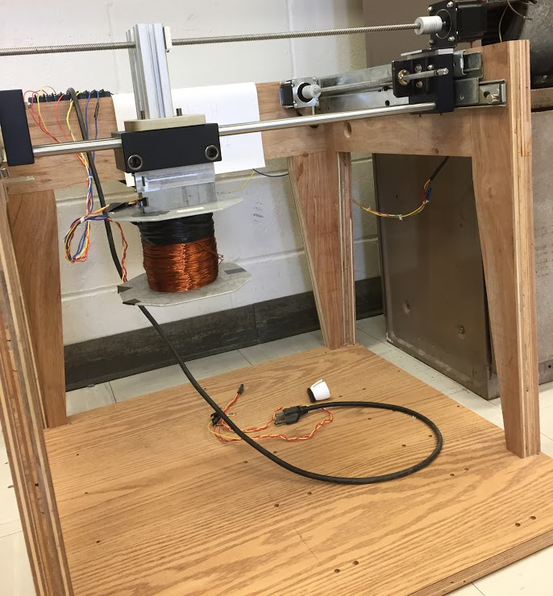
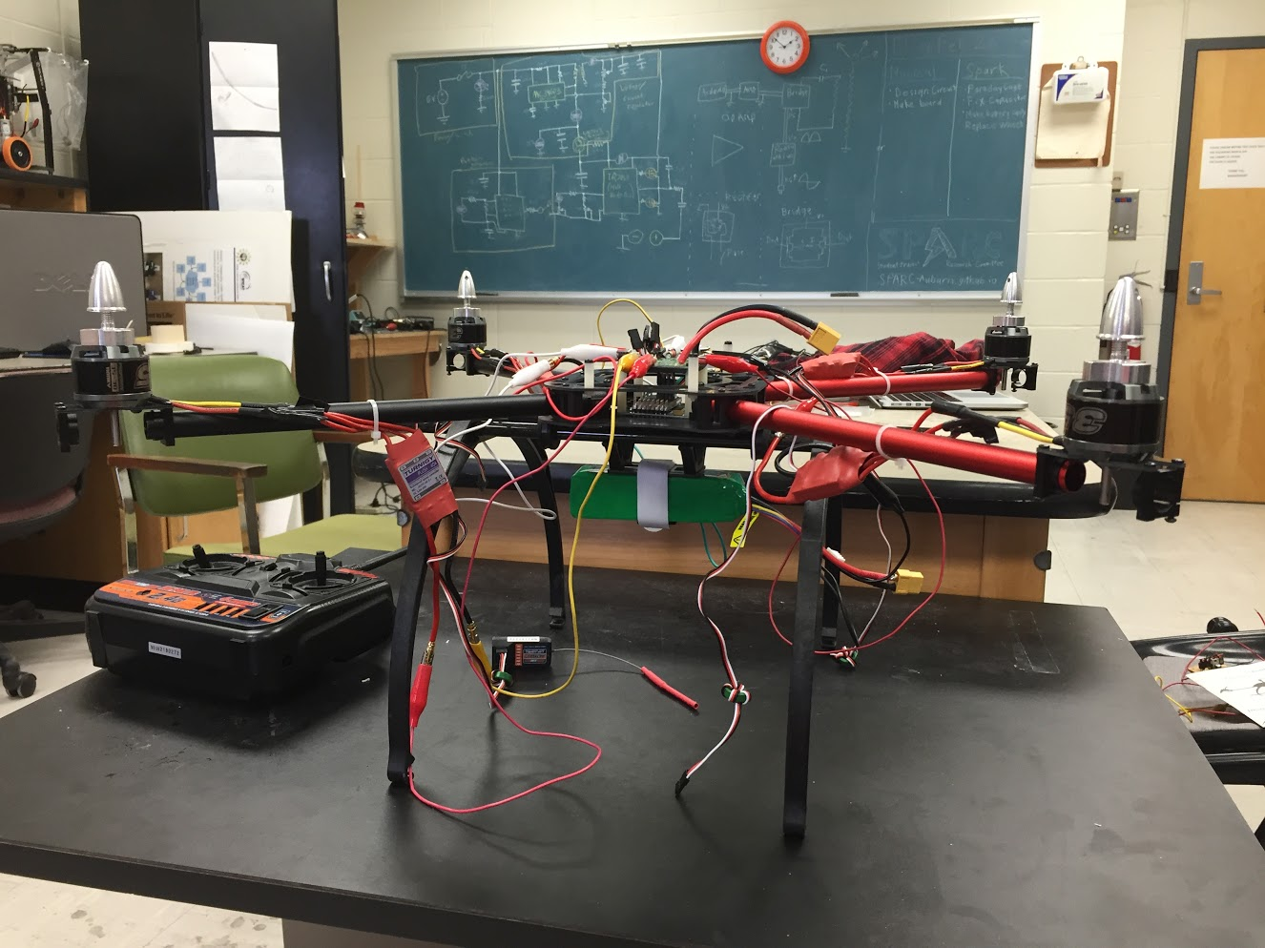
Current Projects and Teams
Robotics and Automation
NASA RMC
Matilda
Automated Lab
Research
Unmanned Aerial Vehicles
XT-8F UAV
Outreach and Demonstration
Claw Machine
Tesla Coil

Slide 7
Projects: NASA Robotics Mining Competition
A 3rd Year Robotics team that designs and builds a robot
collects simulated Martian soil in a small arena
dispenses it into a small bin on the other side of the arena.
Can be remotely controlled or for bonus points autonomously controlled
Competition is held at the Kennedy Space Center
Part of Auburn’s SPACE Club and affiliated with SPARC.
Team Lead:
Jeremy Frasher jjf0010@auburn.edu
Meetings:
Wed 6-7 Mell. Tentative
2016 NASA RMC Robot

Slide 8
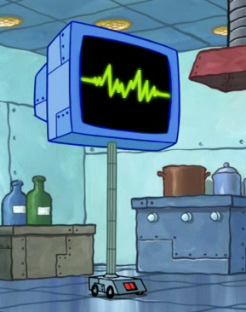

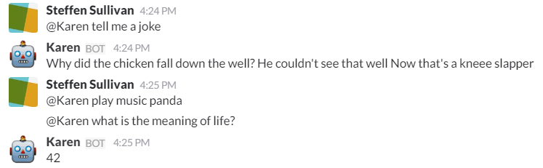
Projects: Automated Lab
Create an automated lab assistant.
Will be voice controlled.
Will allow door to be unlocked temporarily remotely to allow new members access to the lab.
Will consist of both a stationary and mobile system.
Will be embedded on the new group chat system Slack.
Team Lead:
Steffen Sullivan (sbs0034@auburn.edu)
Meetings:
To be determined
Location- SPARC Lab Broun 367
Kinematic
Autonomous
Robot
Enriches
Newcomers

Slide 9
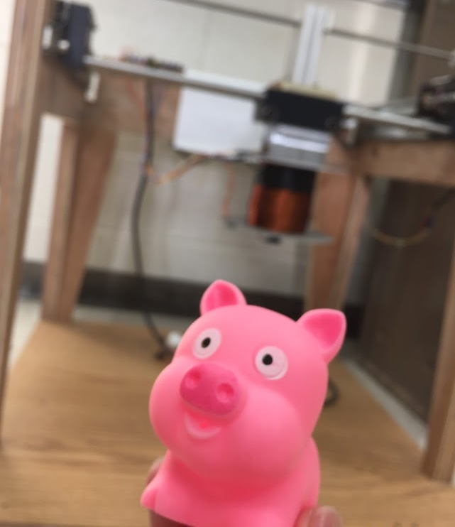
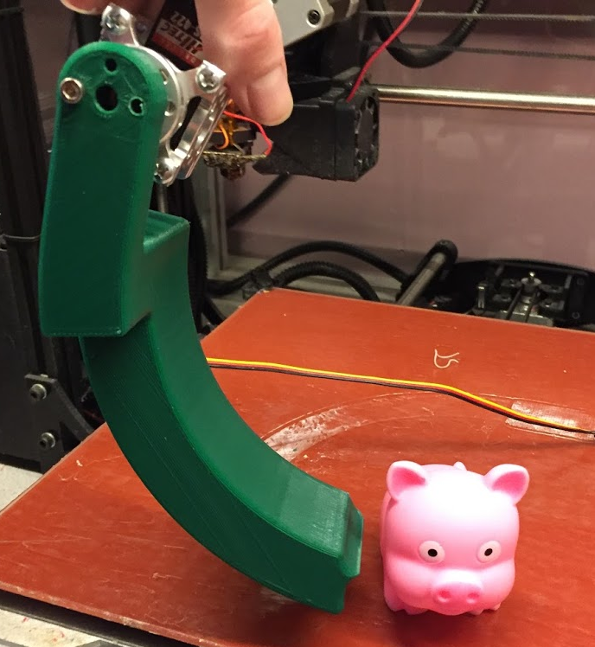
Projects: SCORE Crane Machine
Build a claw machine where “everyone wins”.
Will provide a fun way to distribute promotional items for the Southeastern Center of Robotics Education (SCORE).
Suspend a 3D printed servo controlled claw vertically from the MAGLEV dual axis actuation system.
People will use a joystick to manipulate it and pick objects.
Team Lead:
Shane
Meetings:
TBD

Slide 10
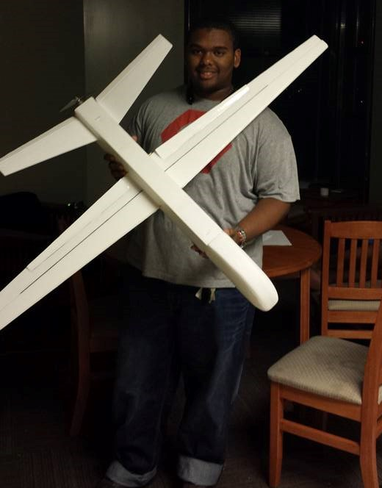
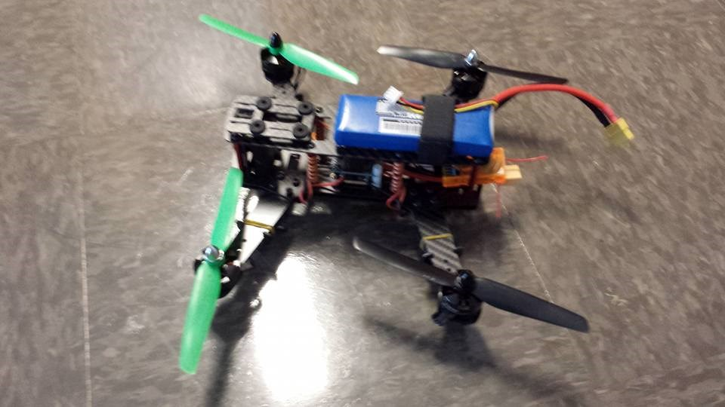
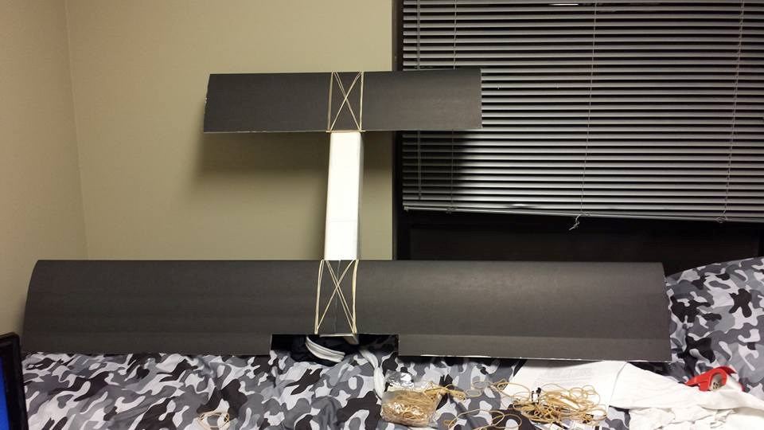
Projects: RC Hobbyist Club (RCHC)
Teaches 3D design, construction and control of RC airplanes, multi-copters, cars, and boats.
Designed to need no prior experience.
Functions very similar to SPARC
Meetings:
Fridays 3:30pm-5:00pm in Broun 235
Dues
$20 (optional)
Club President
Craige LeGrand

Slide 11
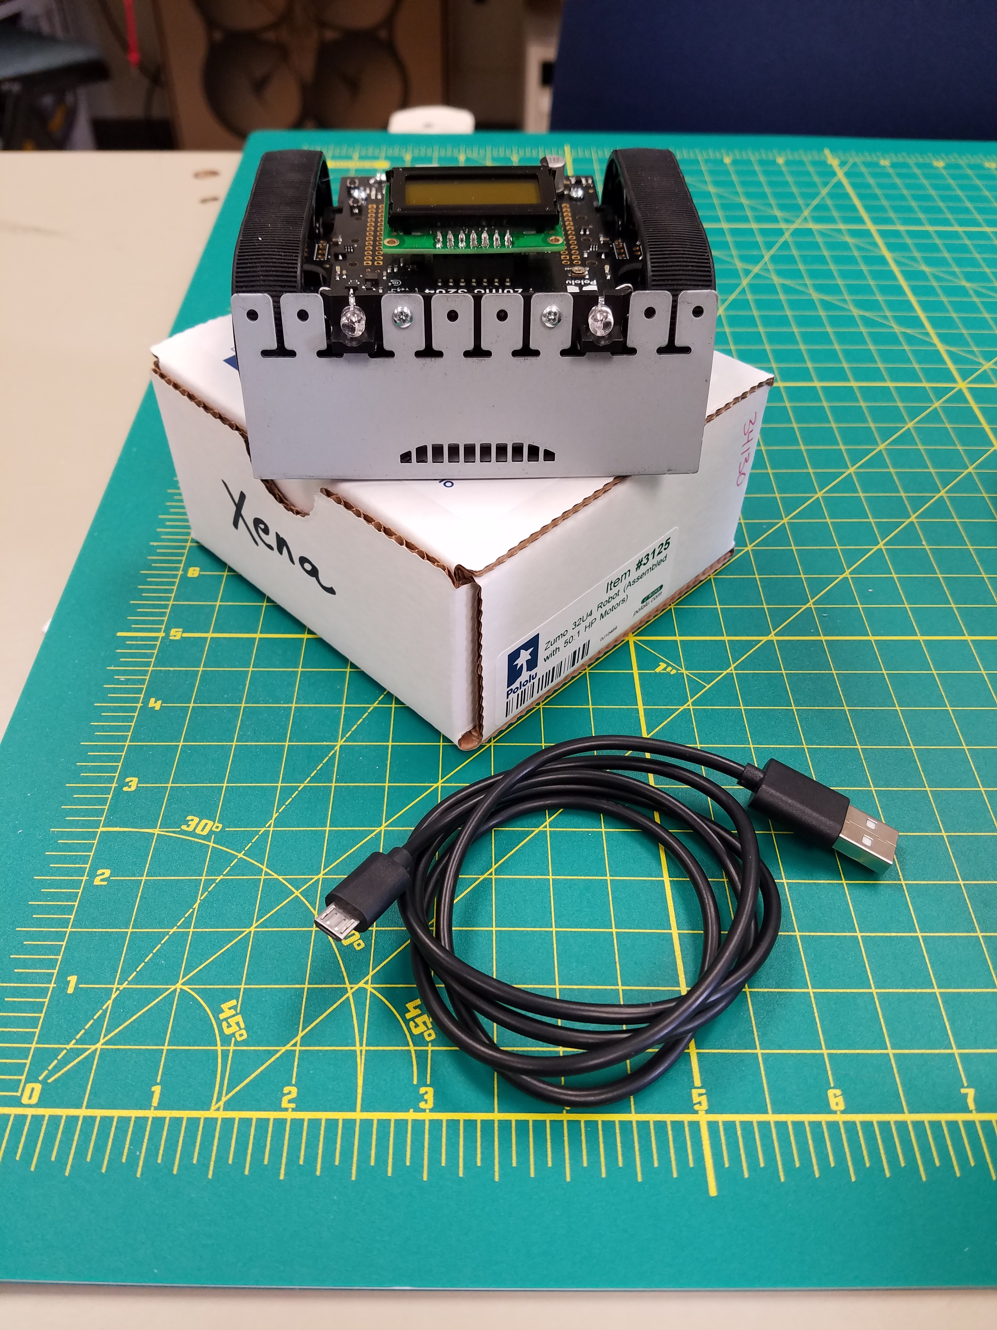
Projects: Zumo Bot
Hope to be a department wide competition.
Runs the Arduino program
Project Lead
Noah Niedzwiecki (nmn0005@auburn.edu)
Meeting Times:
Thursday @ 5

Slide 12
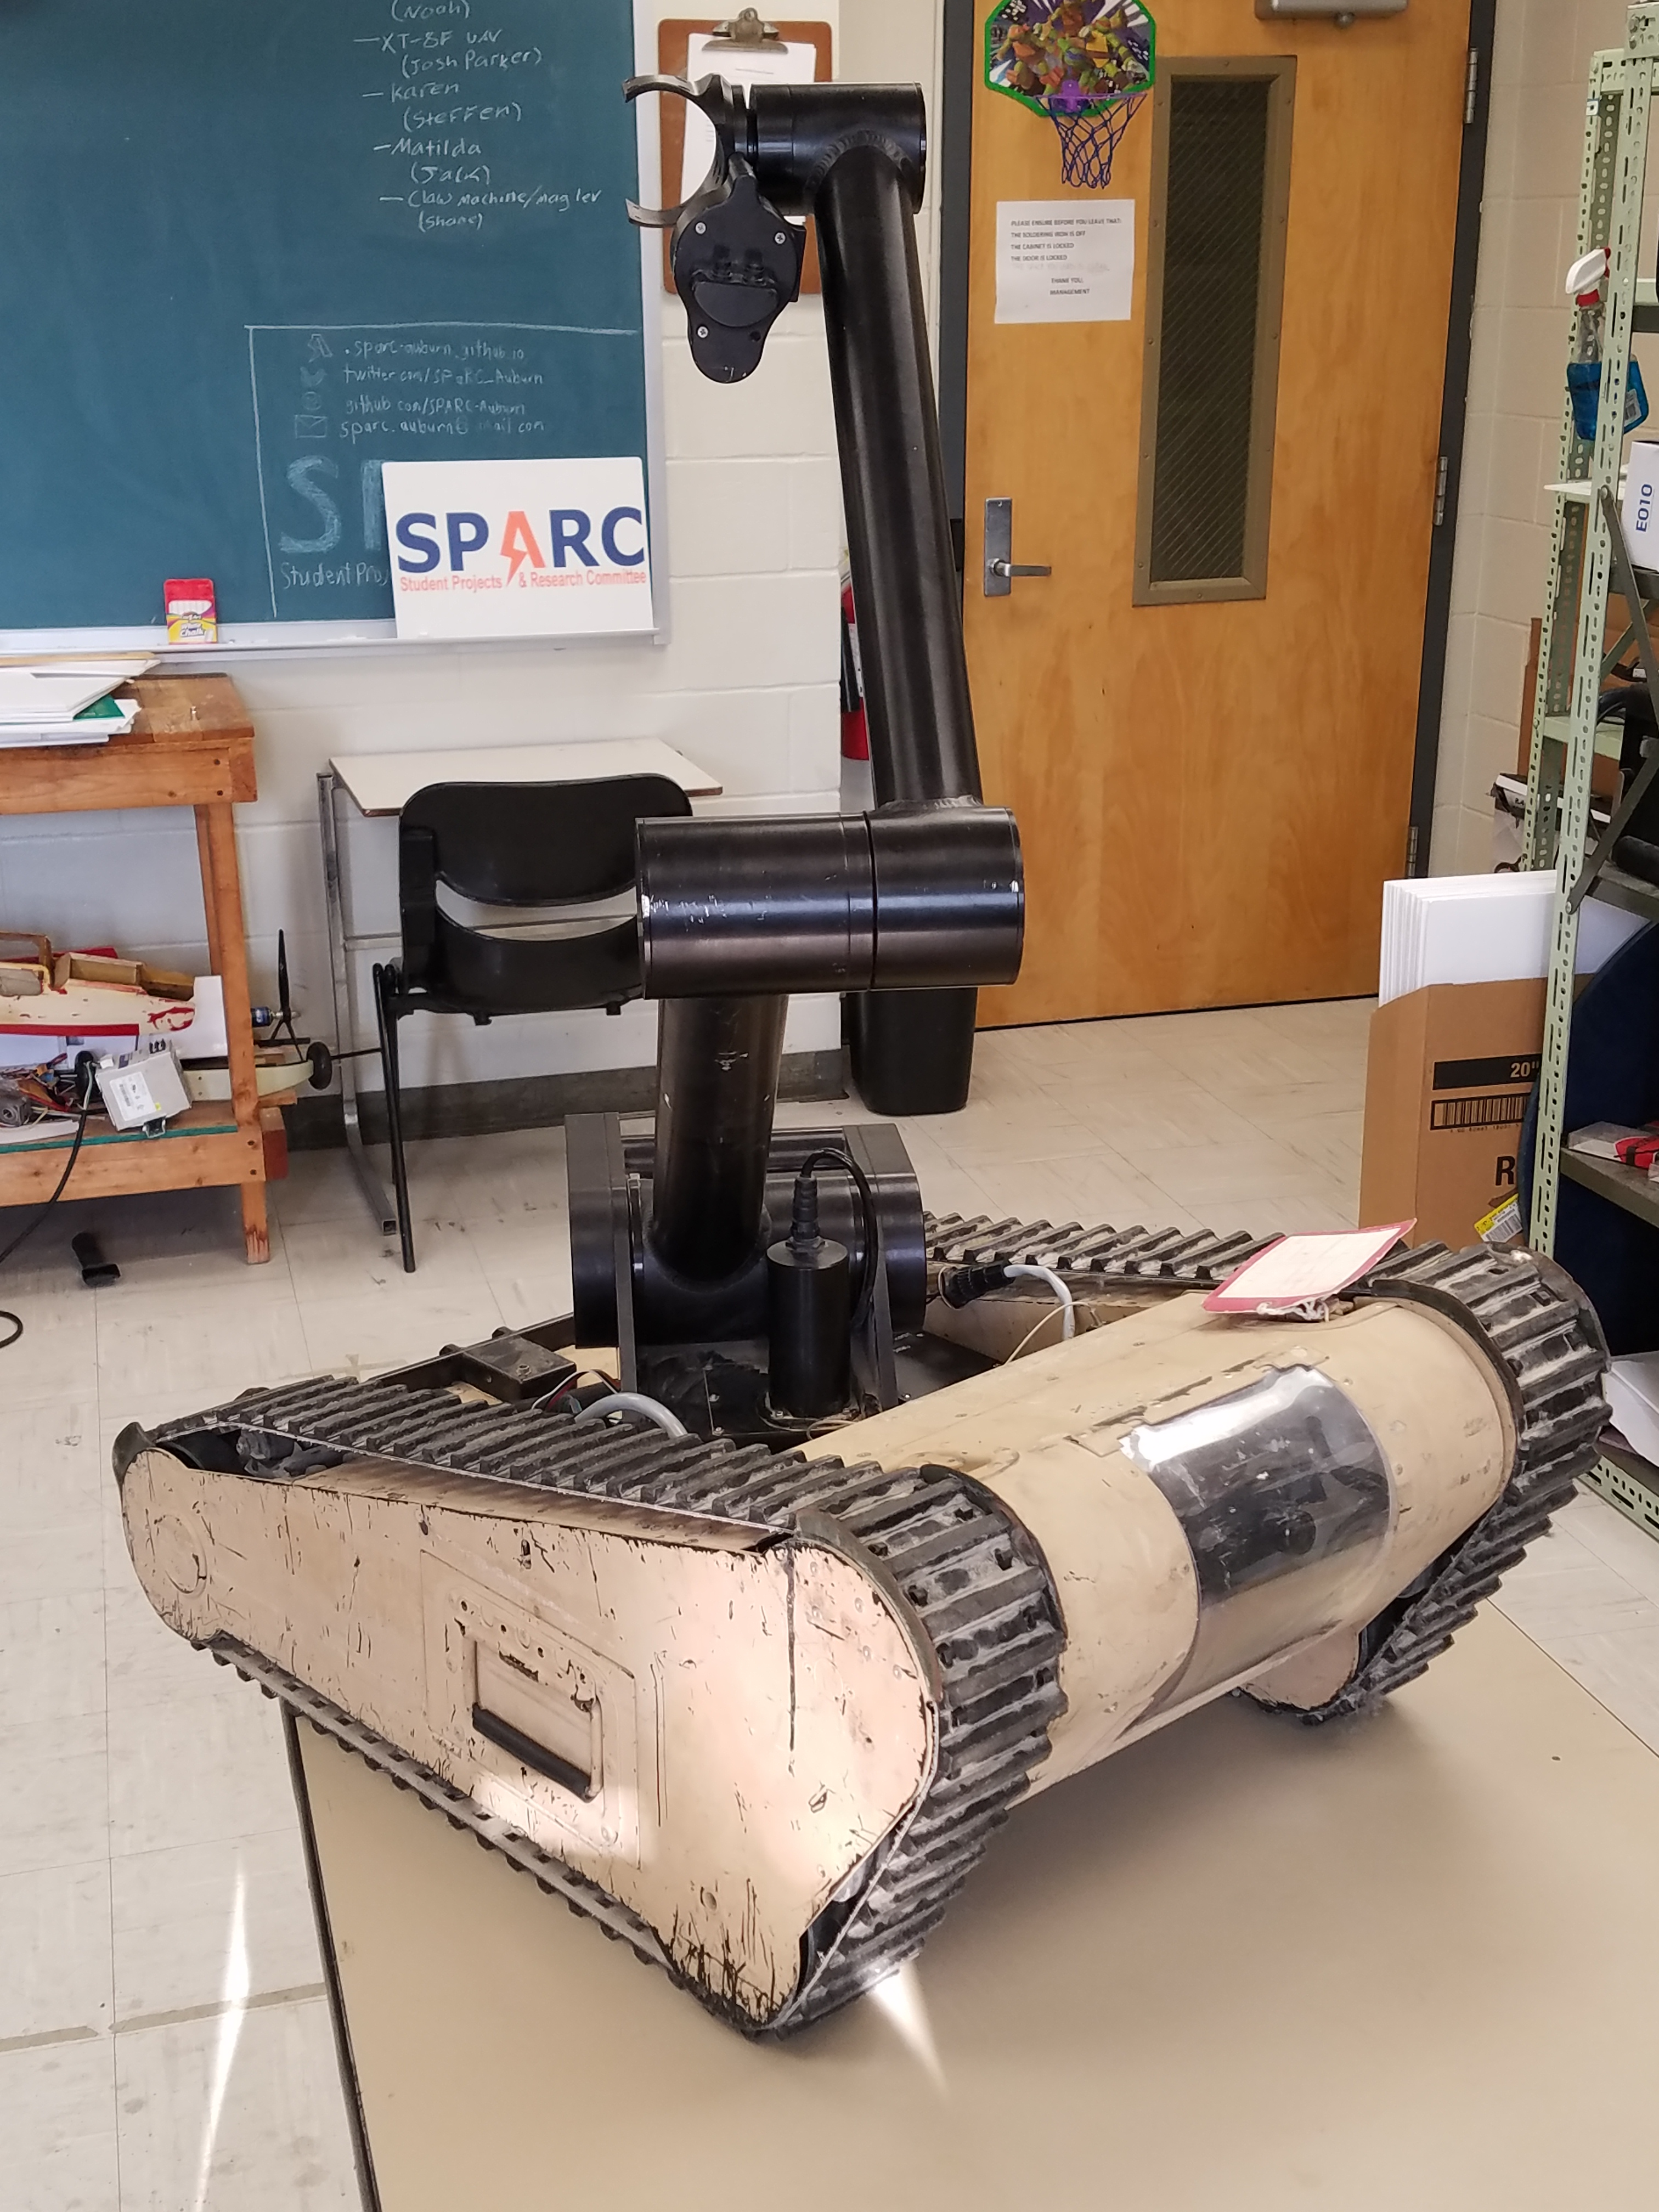
Projects: Matilda
A bomb disposal robot from Dr. Roppel that is currently in disrepair.
Project Lead
Jack Thomas (jet0024@auburn.edu)
Meeting Times:
Wednesday @ 4:30

Slide 13
Questions/Concerns/Updates

Slide 14
Useful Links
Website
http://sparc-auburn.github.io/
Github
https://github.com/SPARC-Auburn
SPARC Documents
https://github.com/SPARC-Auburn/Documents
AU Involve Page
https://auburn.collegiatelink.net/organization/SPARC

